Slide 1
EE281 (Introduction to Electrical Engineering II) and EE285 (Electronics I) BJT Amplifier Configurations
Dr. Melaka Senadeera
Department of Electrical and Electronics Engineering
University of Peradeniya
Peradeniya

Slide 2
Transistor configurations
Transistor configurations
Common base (CB) configuration
(No current gain, but voltage gain)
Common collector (CC) configuration
(Current gain, but no volatge gain)
Common Emitter (CE) configuration
(current gain and voltage gain)

Slide 3
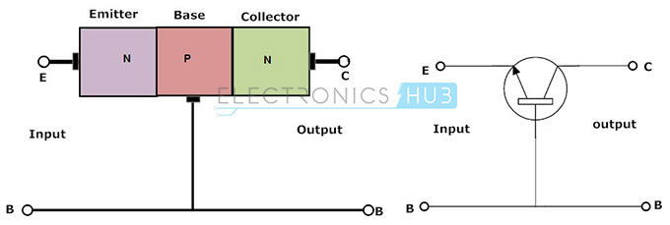
Transistor configurations
Base terminal common to both input and output
The input is applied between the base and emitter
terminals and the corresponding output signal is
taken between the base and collector terminals with
the base terminal grounded
Input parameters are V_{EB} and I_{E} and the output
parameters are V_{CB} and I_{C}.
Notes:
333

Slide 4
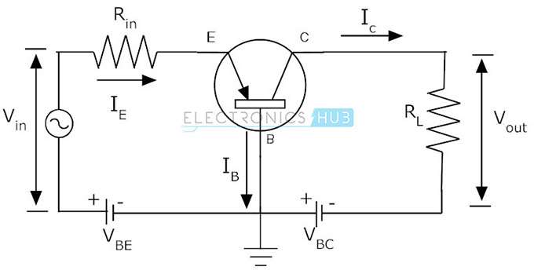
Transistor configurations
Voltage gain for this configuration
A_{V} = V_{out}/V_{in} = (I_{C}*R_{L}) / (I_{E}*R_{in})
Current gain in common base configuration
α = Output current/Input current
α = I_{C}/I_{E}
Notes:
444

Slide 5
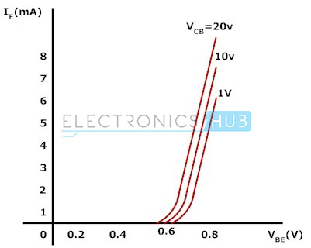
Transistor configurations
Input Characteristics
Input characteristics are obtained between input current and input voltage with constant output
voltage.
Keep the output voltage V_{CB} constant and vary the input voltage V_{EB} for different points then at
each point record the input current I_{E} value.
Repeat the same process at different output voltage levels.
R_{in} = V_{EB} / I_{E} (when V_{CB} is constant)
Notes:
555

Slide 6
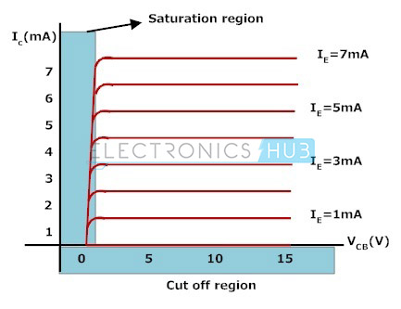
Transistor configurations
Output Characteristics
The output characteristics of common base configuration are obtained between
output current and output voltage with constant input current.
Keep the emitter current constant and vary the V_{CB} value for different points, record the I_{C} values at each point.
The equation to calculate the output resistance value is given below.
R_{out} = V_{CB} / I_{C} (when I_{E} is constant)
Notes:
666

Slide 7
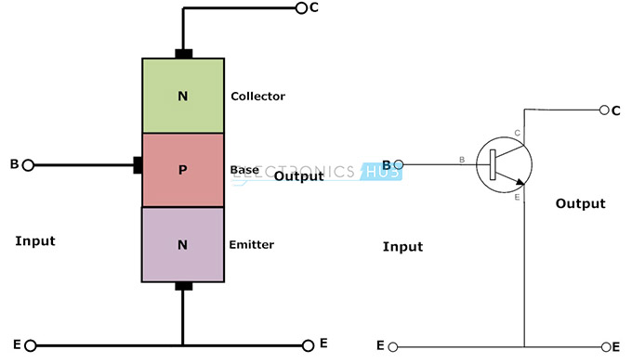
Transistor configurations
Emitter as common terminal for both input and output
Common emitter configuration is an inverting amplifier
circuit.
Input is applied between base-emitter region and the
output is taken between collector and emitter terminals
input parameters are V_{BE} and I_{B} and the output
parameters are V_{CE}and I_{C}.
The input is applied between the base and emitter
terminals and the corresponding output signal is
taken between the base and collector terminals with
the base terminal grounded
Input parameters are V_{EB} and I_{E} and the output
parameters are V_{CB} and I_{C}.
Notes:
777

Slide 8
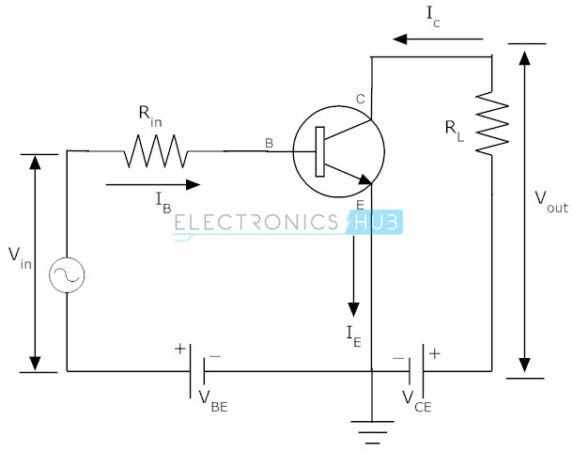
Transistor configurations
Current gains
Current gain (α) = I_{C}/I_{E}
Current gain (β) = I_{C}/I_{B}
Collector current I_{C} =α I_{E} = βI_{B}
This configuration is mostly used one among all the three configurations.
It has medium input and output impedance values. It also has the medium current and voltage gains. But the output signal has a phase shift of 180⁰ i.e. both the input and output are inverse to each other.
Notes:
888

Slide 9
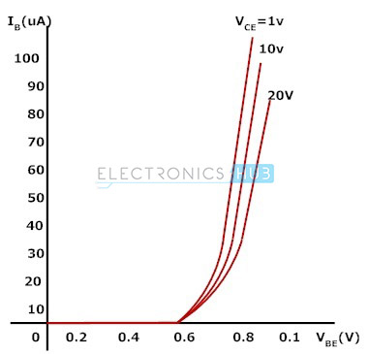
Transistor configurations
The input characteristics
common emitter configuration are obtained between input current I_{B} and input
voltage V_{BE} with constant output voltage V_{CE}.
Keep the output voltage V_{CE} constant and vary the input voltage V_{BE} for different
points
Draw a graph between the values of I_{B} and V_{BE} at constant V_{CE}.
The equation to calculate the input resistance R_{in} is given below.
R_{in} = V_{BE}/I_{B} (when V_{CE} is at constant)
Notes:
999

Slide 10
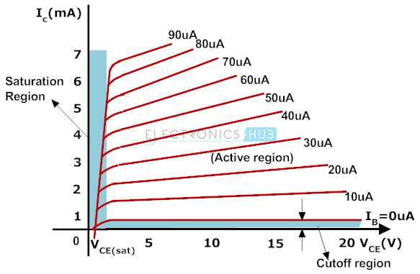
Transistor configurations
Output Characteristics
Common emitter configuration are obtained between the output current I_{C} and output voltage V_{CE}
with constant input current I_{B}.
Keep the base current I_{B} constant and vary the value of output voltage V_{CE} for different points.
Plot the graph between the parameters I_{C} and V_{CE} in order to get the output characteristics of
common emitter configuration.
The equation to calculate the output resistance from this graph is given below.
R_{out} = V_{CE}/I_{C} (when I_{B} is at constant)
Notes:
101010

Slide 11
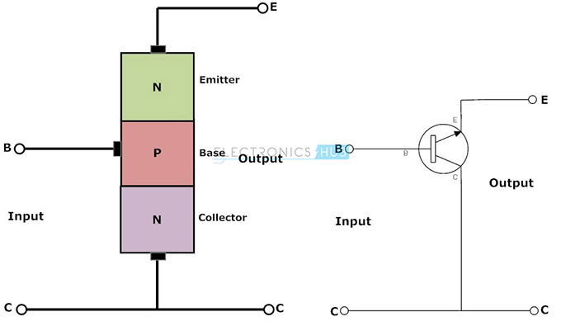
Transistor configurations
Collector terminal as common for both input and
output signals.
input signal is applied between the base-collector
region and the output is taken from the emitter-
collector region
input parameters are V_{BC} and I_{B} and the output
parameters are V_{EC} and I_{E}
Notes:
111111

Slide 12
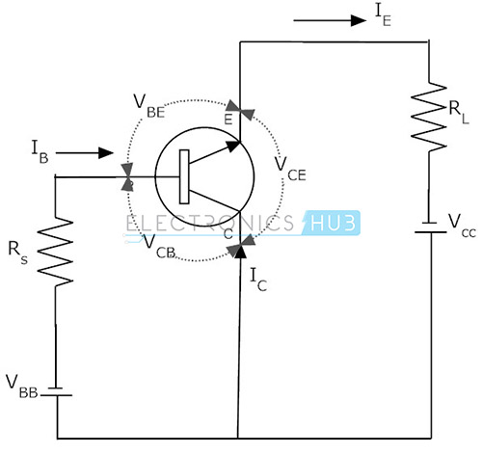
Transistor configurations
Current gain,
A_{i} = output current/Input current
A_{i} = I_{E}/I_{B}
A_{i} = (I_{C} + I_{B})/I_{B}
A_{i} = β + 1
A_{i} = (I_{C}/I_{B}) + 1
This common collector configuration is a non inverting amplifier circuit.
It has large current gain because the load resistor in this circuit receives both the collector and base currents.
Notes:
121212

Slide 13
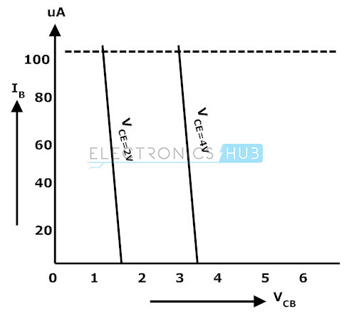
Transistor configurations
Input Characteristics
The input characteristics of a common collector configuration are quite different from the common base and common emitter configurations because the input voltage V_{BC} is largely determined by V_{EC} level. Here,
V_{EC} = V_{EB} + V_{BC}
V_{EB} = V_{EC} – V_{BC}
The input characteristics of a common-collector configuration are obtained between inputs current I_{B} and the input voltage V_{CB} at constant output voltage V_{EC}. Keep the output voltage V_{EC} constant at different levels and vary the input voltage V_{BC} for different points and record the I_{B} values for each point. Now using these values we need to draw a graph between the parameters of V_{BC} and I_{B} at constant V_{EC}
Notes:
131313

Slide 14
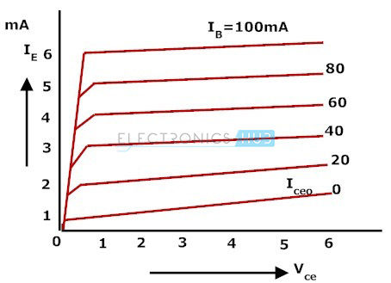
Transistor configurations
Output Characteristics
The operation of the common collector circuit is same as that of common emitter circuit.
The output characteristics of a common collector circuit are obtained
between the output voltage V_{EC} and output current I_{E} at constant input current I_{B}.
In the operation of common collector circuit if the base current is zero then the emitter
current also becomes zero. ‘
As a result no current flows through the transistor
If the base current increases then the transistor operates in active region and finally reaches to saturation region.
Plot the graph between the parameters of I_{E} and V_{CE} at constant values of I_{B}.
Notes:
141414

Slide 15
Thank you
Notes:
151515

